Slide 1
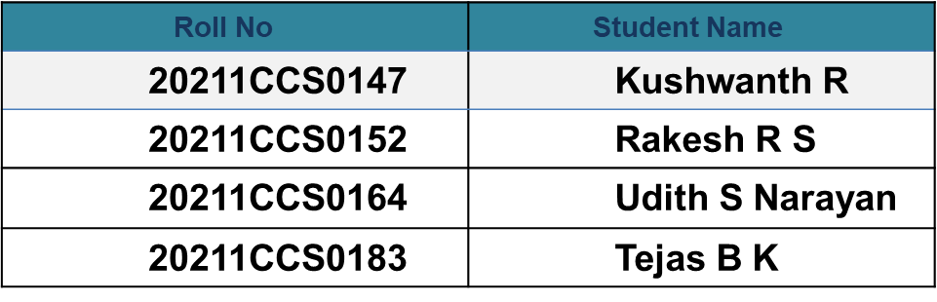
Hospital Finder :Revolutionizing Healthcare
PIP2001 Capstone Project
Review-1
Batch Number: CCS - G32
Under the Supervision of,
Dr./Mr./Ms./Prof. Dr. Vennira Selvi
Professor / Associate Professor / Assistant Professor
School of Computer Science and Engineering
Presidency University
Name of the Program: B tech Computer Science Engineering (Cyber Security)
Name of the HoD: Dr. Anandaraj S P
Name of the Program Project Coordinator: Dr. Sharmasth Vali Y
Name of the School Project Coordinators: Dr. Sampath A K / Dr. Abdul Khadar A / Mr. Md Ziaur Rahman

Slide 2
Introduction
In today's fast-paced world, access to quality healthcare is more crucial than ever. However, navigating the complex landscape of hospitals and medical facilities can be overwhelming for patients and families seeking timely and effective care. Enter Hospital Finder, a groundbreaking solution designed to streamline the process of finding the right healthcare provider. By leveraging advanced technology and user-friendly interfaces, Hospital Finder empowers individuals to make informed decisions about their health, enhancing the overall patient experience.
This innovative tool not only connects users with nearby hospitals and clinics but also provides comprehensive information on services offered, specialties available, and patient reviews.

Slide 3
ABSTRACT
In moments of medical emergencies, individuals often face immense stress and struggle to make swift, informed decisions, such as choosing the most suitable hospital for immediate care. Delays in this decision-making process can critically impact patient survival rates. Our project, Hospital Finder, addresses this challenge by providing a user-friendly application that assists users in identifying the best hospital based on real-time data such as specialist availability, proximity, medical services, and resource availability (e.g., medicines and blood types). The app leverages geolocation and user-specific requirements to recommend the nearest and most appropriate hospital, ensuring rapid access to life-saving care when every second counts.

Slide 4
Literature Review
1. Real-Time Emergency Response Systems in Healthcare
Paper: Real-Time Decision Support System for Emergency Medical Services
Summary: This paper discusses the development of real-time decision support systems (RT-DSS) for emergency medical services. It highlights the importance of real-time data and efficient algorithms to assist in critical decision-making during emergencies.
Relevance: Provides a foundational framework for designing a hospital recommendation system based on location and service availability.
2. Mobile Health Applications for Emergency Care
Paper: Mobile Health Applications in Emergency Situations:
Summary: This review paper discusses various mobile health (mHealth) applications designed to improve emergency care. It evaluates the features, challenges, and effectiveness of mHealth apps in providing timely assistance in critical situations.

Slide 5
Literature Review
3. AI in Healthcare: Emergency Systems
Paper: Artificial Intelligence in Emergency Medicine: Current and Future Applications
Summary: This paper reviews the use of AI in emergency medicine, including AI-driven decision support systems. It also addresses how AI can help streamline hospital selection based on patient-specific needs and available resources.
Relevance: Supports the integration of AI for more personalized recommendations and predictive analytics in hospital selection.
4. Optimization of Hospital Resources and Availability
Paper: Resource Optimization in Hospitals for Emergency Situations
Summary: This research focuses on how hospitals can optimize their resources, such as ICU beds, specialists, and medical equipment, for better emergency handling.
Relevance: Can be used to model the real-time availability of hospital resources in your app.

Slide 6
Literature Review
5. Impact of Real-Time Data on Emergency Healthcare
Paper: Impact of Real-Time Data on Healthcare Decision Making in Emergency Scenarios
Summary: Discusses the impact of real-time data, including patient vitals and hospital resource data, on healthcare decision-making in emergency situations. It emphasizes the importance of having accurate, up-to-date information in life-or-death scenarios.
Relevance: This is relevant for integrating real-time hospital data feeds into your application.
6. Healthcare Navigation Systems for Emergency Cases
Paper: Design and Implementation of Healthcare Navigation Systems for Emergency Services
Summary: This research focuses on healthcare navigation systems that guide users to the best hospitals during emergencies. It discusses UI/UX design and the technical challenges of integrating such systems.
Relevance: Provides guidelines on how to structure the user interface and system architecture for seamless navigation.

Slide 7
Literature Review
7. IoT and Smart Healthcare Systems for Emergency Response
Paper: IoT-Enabled Smart Healthcare Systems for Improved Emergency Response
Summary: This paper presents an IoT-based system for monitoring patients and hospital conditions to improve emergency response times. It explores sensor-based data gathering and real-time analysis for resource allocation.
Relevance: Supports the integration of IoT technologies to monitor real-time hospital resource availability.
8. Patient-Centric Healthcare Applications in Emergencies
Paper: Patient-Centric Mobile Applications in Emergency Healthcare: Challenges and Solutions
Summary: This research discusses the design of patient-centric applications for emergencies, focusing on the user experience, data privacy, and the ethical considerations involved in handling sensitive medical data.
Relevance: Provides insights into designing user-friendly, secure apps for sensitive and time-critical situations.

Slide 8
Literature Review
9. Location-Based Services for Healthcare Applications
Paper: Geolocation and Proximity Services for Healthcare Applications
Summary: The research focuses on geolocation services and how proximity data can be used in healthcare applications to optimize emergency responses. It discusses various algorithms for determining proximity and integrating it into healthcare apps.
Relevance: This work is critical to implementing location-based hospital recommendations.
10. Hospital Recommender Systems Using Data Analytics
Paper: Data-Driven Recommender Systems for Hospital Selection in Critical Conditions
Summary: This paper presents a recommender system that uses patient data, hospital statistics, and proximity to suggest the best hospital. The system uses big data analytics to process and filter the information.
Relevance: Aids in understanding the data-driven recommendation models for hospital selection.

Slide 9
Existing method Drawback
Key Drawbacks:
Lack of Real-Time Information: Most systems do not provide real-time updates on hospital resources like specialist availability, beds, or equipment.
Slow Decision-Making: Current methods rely on manual or delayed information, which wastes precious time in emergencies.
Limited Personalization: Many systems fail to take into account individual patient needs, such as specific medical conditions, proximity, or insurance coverage.
Overload at Certain Hospitals: Patients often choose the most familiar or closest hospital, leading to overcrowding and resource depletion at those facilities, while other hospitals may have available resources.
Fragmented and Isolated Data: Information is often scattered across different platforms (directories, websites, apps) with no integrated system that offers a holistic view.

Slide 10
Proposed Method
Real-Time Updates: Accurate and up-to-the-minute data ensures that users are always directed to the hospital best equipped to handle their specific emergency.
Personalization: By tailoring hospital recommendations to the patient's emergency type, location, and personal preferences (e.g., insurance coverage), the app significantly enhances decision-making.
Faster Response: The system’s use of geolocation and live traffic updates ensures that the recommended hospital is not only suitable but also reachable in the shortest possible time.
Reduced Overcrowding: By dynamically considering hospital capacity and workload, the system helps distribute patients evenly, reducing the likelihood of overburdening certain hospitals.
Comprehensive Data Sources: Integration with various data sources (hospitals, navigation systems, insurance databases) ensures that users receive holistic, informed recommendations.

Slide 11
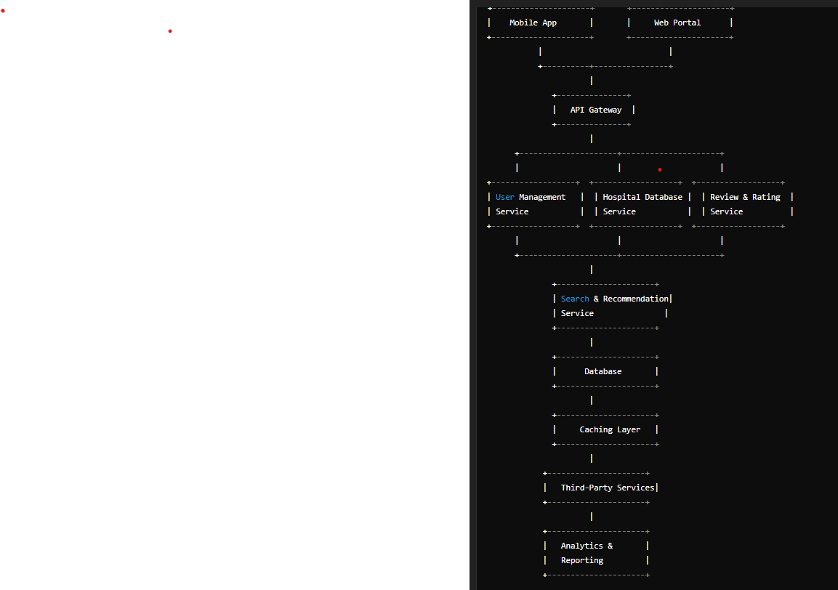
Architecture Diagram

Slide 12
Software and Hardware Details
Software Requirements:
1. Development Tools:
Code Editor:
VS Code : Lightweight and feature-rich code editor.
PyCharm : Python-specific IDE with powerful debugging tools.
2. Backend:
Node.js: For backend development with Express.js.
SQL Database:
MySQL : For managing hospital and user data.
MySQL Workbench : Tools for managing and visualizing databases
3. Frontend:
HTML/CSS/JavaScript: For frontend development. Basic tools like a code editor will be enough.
Bootstrap: For styling and making the app responsive.

Slide 13
Hardware and Software Details
4.APIs:
Google Maps API: For geolocation and directions.
5.Version Control:
Git: For version control and collaboration.

Slide 14
Hardware and Software Details
Hardware Requirements:
1. Development Machine:
Operating System: Windows, macOS, or Linux.
Processor: Intel Core i5 or equivalent.
RAM: 8 GB minimum
Storage: At least 100 GB free space

Slide 15
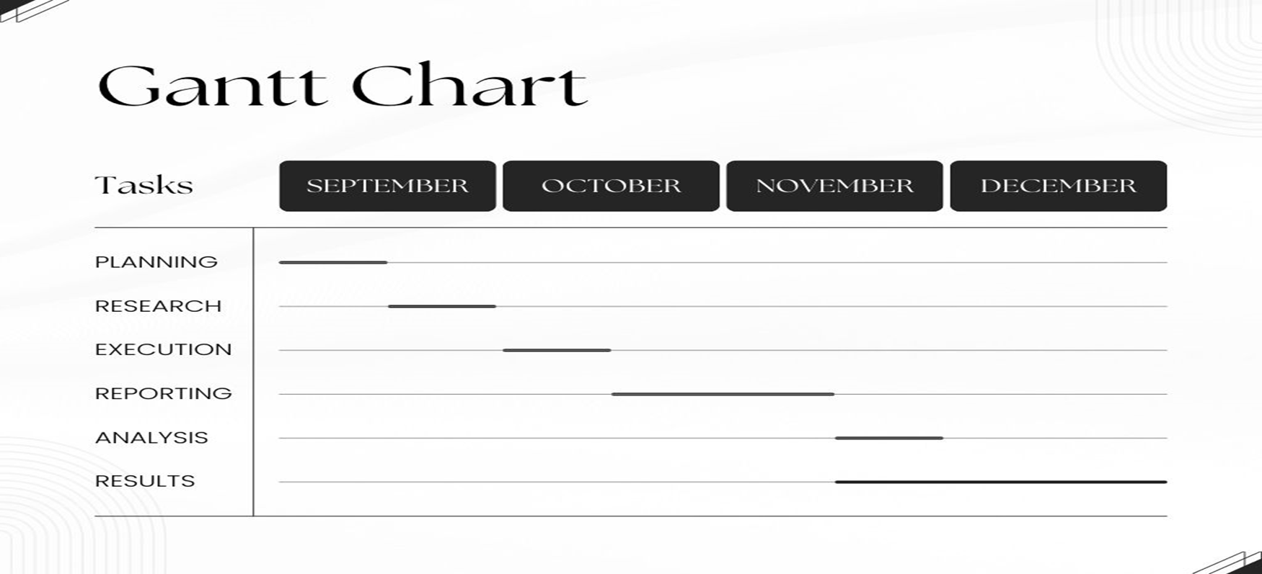
Time Line By Gantt Chart

Slide 16
Github Link
https://github.com/kushw-cloud/Hospital_Finder
Github Link

Slide 17
Thank You

